Slide 1
The Effect of Performance Targets on Reception Class Teachers’ Pedagogical Approaches – Evidence from Practice.

Slide 2
INTRODUCTION
Notes:
This presentation is part of a larger study that was commissioned by UNICEF on Behalf of the MOBE. The contract was awarded to BERA which assembled a team of seven members to conduct the study.

Slide 3
PURPOSE
Provide evidence that would inform quality improvements;
Rolling out of the programme to all public schools by 2020.
SPECIFIC OBJECTIVES
Efficiency in the delivery of the programme
Effectiveness of the programme in terms of outputs and outcomes.
Provide key recommendations
Notes:
The purpose of the study was to provide evidence that would
Provide evidence to inform quality improvements and the rolling out of the programme to all public schools by 2020.
Amongst the specific objectives of the study was to:
1. determine the efficiency in the delivery of the programme, particularly assessing the adequacy of inputs such as curriculum and teachers, and
2. Determine amongst others the effectiveness of the programme in terms of inputs and outputs. And
3. Finally to provide recommendations.

Slide 4
LITERATURE REVIEW
Universal understanding of ECCE as discussed from reviewed literature:
Critical stage of learning for sustainable societies and economies
Human right
Multi-dimensional
Shift from fragmented ECCE services to an integrated approach
More development of ECCE related policies and programmes than there is evaluation.
Notes:
Literature reviewed from Kenya (Mwauraa, Sylvab, & Malmbergb, 2008),
South Africa (Atmore, 2013), and
Botswana (Maundeni, 2013; Tsamaasse, 2014; Andrews, Galeforolwe, Ratsoma & Evans, 2006; Bose, 2008) revealed that provision of ECCE services in any country is more than just a way to conform to international standards but rather a human right.
ECCE carries varied names such as pre-school, Cretche, Kindergarten, play group and reception class.
Shift from fragmented ECCE services to an integrated approach in the majority of countries
Despite much activity in the development of policies related to ECCE in Botswana and in the region, in contrast there has been less activity related to the evaluation of ECCE programmes and policies

Slide 5
THEORETICAL FRAMEWORK
Provus’s Discrepancy evaluation model
S
T
Stage
1
c
D
M
P
R
Notes:
Much of the study relied on evaluative research design based on a combination the CIPP and the Provus’s Discrepancy evaluation models

Slide 6
METHODOLOGY
Multi Method Design
Evidence of the performance of the RCP in terms of efficiency and effectiveness.
Qualitative study
Quantitative study
Determine the efficiency in the delivery of the programme particularly assessing the adequacy of inputs.
Determine the effectiveness of the programme in terms of outputs.
Observations
Questionnaires
Document Analysis
Questionnaire
Notes:
However, as stipulated in the TOR the overall objective of the study was to generate evidence of the performance of the RCP in Botswana in terms of its efficiency and effectiveness, including impact on children’s school readiness and performance.

Slide 7
SAMPLING CRITERIA
10% of the schools with the RCP from each of the 10 regions
RCP classes started in 2014
Sub regions
Locale within which schools were situated
Notes:
Kweneng and Central had the number of school at 8 and 19 respectively.
For the eight remaining districts, the 10% of the schools was small and so the number was increased to 4. This applied to most of the districts except South which had 6 schools. This explains why we ended up with 61 sampled schools instead of 54 schools.
Selection of the other participants did not require any sampling since all of them were considered as participants, except for parents, on whom we used Purposeful Random Sampling procedure to select 3 parents who have children in the RC in the selected schools.

Slide 8
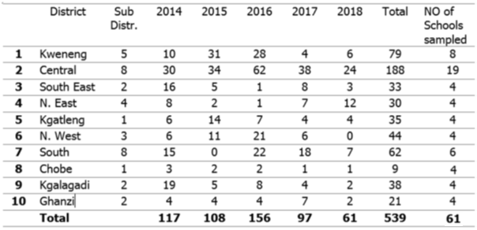
NO OF SCHOOLS SAMPLED PER REGION
Notes:
From the sampling criteria discussed above, the following sample no of schools was reached.

Slide 9
INSTRUMENTATION
Notes:
These are instruments that were used for each group of participants.

Slide 10
RCP TEACHERS DEMOGRAPHICS
Participants | Gender |  | Age range |  |  | Educational background |  |  | Total
RCP Teachers | Male | Female | 21 -31 | 32 -41 | 42+ | Degrees | Diplomas | Certificates
 | 5% | 95% | 42% | 39% | 19% | 9% | 79% | 12% | 79

Slide 11
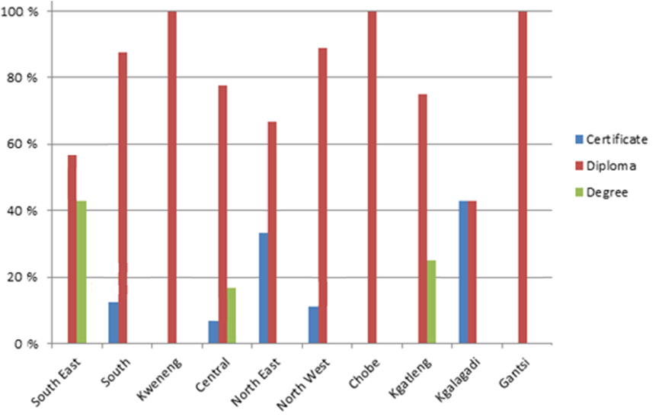
Teachers’ qualifications by region
Notes:
Teachers’ qualifications was another input that was assessed to determine efficiency in the delivery of the curriculum.
Kweneng, Chobe and Gantsi had 100% qualified teachers with Diploma in Early Childhood Education followed by North West and South at 88.9% and 87.5% respectively, and Central, Kgatleng, North East, South East, and Kgalagadi at 77.8%, 75%, 66.7%, 57.1, and 42.9% respectively. Regions that did not operate at 100% diploma level qualifications had teachers qualified at certificate and degree levels in Early Childhood Education.
These results are a clear indication that RCP teachers were well qualified to handle the RCP curriculum. School heads, who are the actual supervisors of these teachers also rated teacher qualifications highly. They mostly rated RC teachers as either qualified, adequately qualified or over qualified

Slide 12
RESULTS AND FINDINGS
Levels of complexity | Common action verbs related to Competencies | Level of Coverage of the Curriculum competencies
Creating
Evaluating
Analysing | Compare; Contrast; Distinguish; Differentiate; Classify; Discriminate. | Two found at this level (2/13)
Applying | Demonstrate; Dramatize; Interpret; Solve; Use; Illustrate; Convert; Discover; Discuss; Compare. | Majority pitched at this level (10/13)
Understanding | Interpret; Exemplify; classify; Summarize; Infer; Compare; Explain; Rephrase; Discuss | One found at this level (1/13)
Remembering | Define; Duplicate; Memorize; List; Repeat; Reproduce. | None found at this level
Notes:
The inputs assessed to determine their adequacy were the Curriculum and Teachers.
The curriculum was found to be adequate in terms of skills expected at reception class level. However, level of coverage appears to be highly pitched where the majority of skills and competencies are heavy on the requirement for complex understanding of relationships between concepts. None of the skills and competencies are covered at level 1, which is the introductory or developmental level, and only one skill area (Communication) is covered at level 2.

Slide 13
. . . I realize that kids are not trained on fine motor skills and socializing, how to walk, how to do this and that rather on reading and writing, basically, RC should be a foundation of everything but now kids are being damaged by being made to read and write. . . (PEOKW)
Learners should be given pre reading, pre writing activities. At the same time they should be given time to play. They should not be taught as if they were in the primary school classroom . . . In some schools e.g. in (Name of school withheld) the learners were writing as if they were in standard 3. It seems the Deputy School head advised teachers to teach.” (PEOHK)
Notes:
The lack of coverage of skills and competencies at introductory or foundation level was also captured in interviews.
There were references made during interviews which indicated that due to pressure from parents and supervisors, teachers may be pitching the level of the RCP syllabus coverage higher than the expected level of 4 – 5 year olds.

Slide 14
Levels of complexity | Common action verbs related to Competencies | Level of Coverage of the Curriculum competencies
Creating
Evaluating
Analysing | Compare; Contrast; Distinguish; Differentiate; Classify; Discriminate. | Two found at this level (2/13)
Applying | Demonstrate; Dramatize; Interpret; Solve; Use; Illustrate; Convert; Discover; Discuss; Compare. | Majority pitched at this level (10/13)
Understanding | Interpret; Exemplify; classify; Summarize; Infer; Compare; Explain; Rephrase; Discuss | One found at this level (1/13)
Remembering | Define; Duplicate; Memorize; List; Repeat; Reproduce. | None found at this level

Slide 15
Observations
During observation not even a single incident was recorded where teachers were bothered to check through the performance indicators to determine if learners were developmentally on track in terms of processes leading to attainment of Performance targets or competencies.
Notes:
In all the classes observed not even a single incident was recorded where the teacher was bothered to check if pupils were developmentally on track in terms of processes leading to attainment of Performance Targets. In most cases these pupils were treated like little adults and told to sit still.

Slide 16
DISCUSSIONS AND CONCLUSIONS
While RCP teachers are capable of completing the syllabus, thereby assisting learners to grasp skills;
While RCP teachers are able to assist learners to fulfil performance targets; and
While RCP teachers are well qualified;
It is important that their desire to fulfil performance targets should not derail their pedagogical approaches to overlook important developmental processes.
Notes:
It can be concluded that RC teachers are capable of completing the syllabus, thereby assisting learners to grasp various social, psychomotor and cognitive skills.
RC teachers are also able to assist learners to be creative and innovative; think critically, solve problems and make decisions as well as being able to learn and work alone or with others.
When coupled with the finding that most RC teachers were qualified (with certificates, diploma and bachelor’s degrees in early childhood), it is not surprising that their overall performance is mostly above average an assertion that links quality early learning and development to the educational qualifications of teachers.

Slide 17
Recommendations
RC teachers should adopt learning through play as the major pedagogical approach used in the development of skills and competencies from the curriculum framework.
RC teachers should pay particular attention to processes leading to acquisition of skills and competencies as opposed to focusing more on performance indicators.
Regular capacity building activities for parents and school management should be part of the implementation strategy for the RCP.
The MOBE should collaborate with training institutions to ensure that ECCE graduates are appropriately trained to adopt pedagogical approaches relevant to learners at aged 2-5 years old.
Notes:
The following recommendations are made to address the issues that have been identified under the specific objective of this study. This being to determine amongst others the effectiveness of the programme.

